Slide 1
Getting Ready to Apply: Four Year Public Colleges in Colorado
Juliette Bryant
Admissions Counselor

Slide 2
“The college search process is a match to be made, not a race to be won…

Slide 3
Agenda
Admissions “jargon”
A Formula for Success
Senior Year Timeline
Resources and Helpful Tips
Questions

Slide 4
Admissions Jargon
AP/IB/Dual/Concurrent enrollment
Test Optional vs Test Blind
Rigor
Early Action vs Early Decision
Rolling vs Reply Date Admission
Holistic Review
First Generation and Legacy College Student

Slide 5
Early Action vs. Early Decision
Early Action: Non-binding
+ receive early notification of an admission decision
+ apply to and compare financial aid offers from other schools
Early Decision: Binding
+ allows more time to prepare for the transition from high school to college
- cannot compare financial aid offers

Slide 6
Rolling vs. Reply Date Admission
Rolling Admission
Decisions are rendered on an ongoing basis as applications become complete.
Reply Date Admission
Decisions are pooled and released all at one time.

Slide 7
Holistic Review
Considers a student’s:
Interests
Passions
Special talents
Personality
Background
Experiences
Academic Preparedness

Slide 8
Rigor
+ Higher Education Admission Requirements (HEAR)
+ Types of courses (e.g., AP, IB, honors)
+ Number and/or sequencing of courses

Slide 9
AP/IB/Dual or Concurrent Enrollment
+ academic preparedness
+ college credits

Slide 10
Test Optional vs Test Blind
Test Optional
Students may submit test scores that can be used in the admissions review process, but they are not required.
Test Blind
Test scores are not collected or accepted or used in the admissions review process at all.

Slide 11
First Generation and Legacy
First Generation College Student
A First Generation student is one whose parents have not completed a bachelor's degree. It doesn’t matter if siblings have completed a bachelor’s degree.
Legacy College Student
A legacy student is someone who has a close family member, normally a parent, who attended the same college.

Slide 12
College Priorities Checklist
Admission Eligibility
Size
Setting
Academics
Type
Cost of Attendance
Living Accommodations
Student Services and Activities
Student Population
Additional Factors

Slide 13
What is new in Colorado admissions
2023 Colorado Free Application Day$:
Tuesday, October 18th, 2022 - Thursday, October 20th, 2022
Colorado is "Test Optional"!
On May 25, 2021, it became state law that Colorado's public four-year colleges and universities do not need to require SAT or ACT scores for the admission process.
Legacy Cannot be Considered in Admission:
Colorado's public four-year colleges and universities can no longer consider legacy in the admission process.
Started in 2017
Typically in mid-October
Applicants can no longer benefit in the admission process if they had family attend the institution to which they are applying.

Slide 14
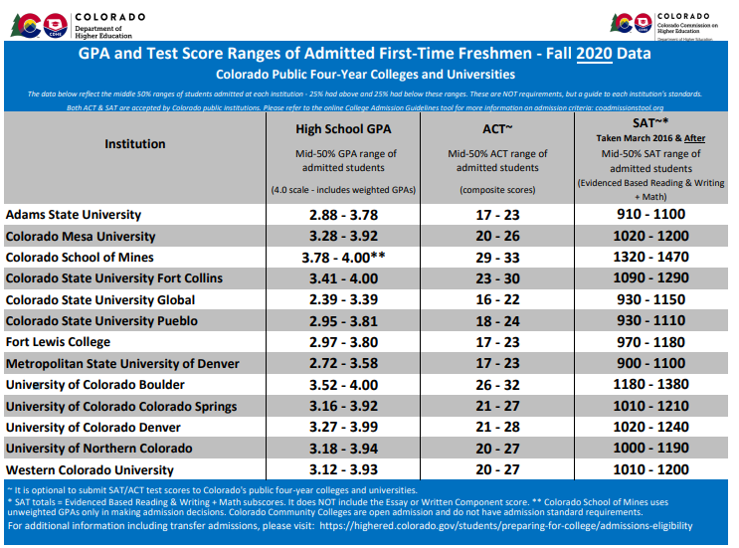

Slide 15
Senior Year Timeline: Fall Semester
Meet with your Counselor
Attend College Fairs/Rep Visits
Request Official High School Transcripts
Request Letters of Recommendation
Prepare Essays
Declutter your Inbox
Visit Colleges

Slide 16
Senior Year Timeline: Spring Semester
Complete Next Steps for College of Choice
Apply for all possible scholarships
Apply for Need Based Aid (FAFSA)
Visit Colleges you applied to
National Decision Day (May 1st)
Send in Final Transcript
Attend Orientation

Slide 17
Resources
Colorado Collegiate Handbook
Denver National College Fair- Date/time TBA
Admissions Counselors

Slide 18
Helpful Tips
Join college mailing lists, remove yourself as you narrow your choices.
01
Schedule a visit to campus to learn more or explore virtual visits. See for yourself!
02
Connect with admissions counselors at schools that interest you.
03
Schedule a meeting with your high school counselor to talk about your college options.
04
Challenge yourself, appropriately and academically.
05
Join new clubs, organizations or community service efforts.
06

Slide 19
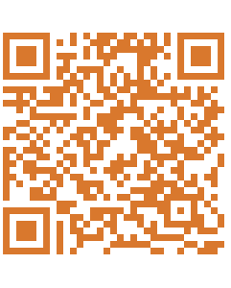
Stay in Touch!
Juliette.Bryant@colostate.edu
Phone: (970) 491 – 0908
Text: (970) 431 - 6149

