Slide 1
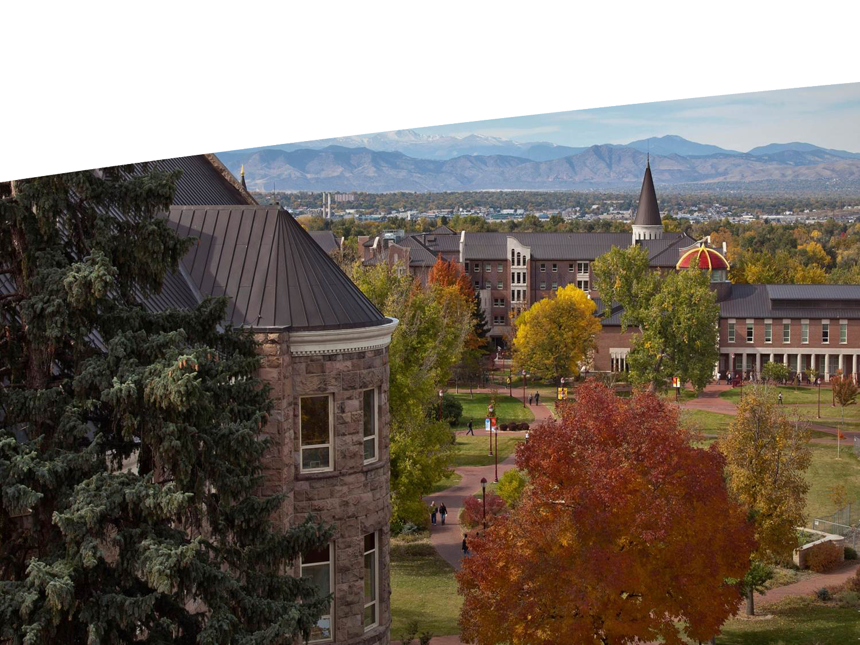

Slide 2
Applying to Selective Colleges
Nicholas Taylor (Substitute) Chatfield Senior High Counselor

Slide 3
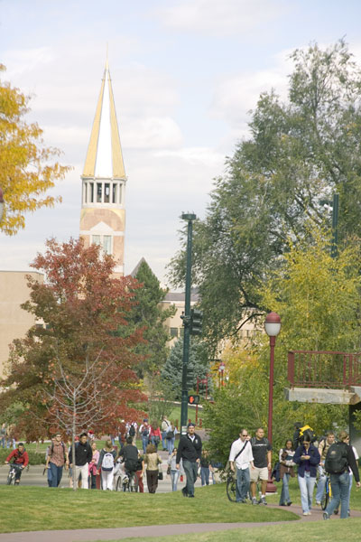
Private vs. Public
It’s all about the money
Public colleges/universities receive some sort of financial support from the state
Private colleges are supported by tuition, endowment, and donations from alumni and friends
Look at net price, not just sticker price
Do your research- remember that one size does NOT fit all. Know what you want in a school!

Slide 4
Public Schools
Public Flagship Universities:
Are the main public colleges in the state and are often larger (e.g. Ohio State University, Penn State University, University of Colorado – Boulder)
Draw students from around the state & abroad
Can be more selective than other public schools in the state
Smaller Public Colleges and Universities:
Smaller (typically)
Draw students from their immediate region with less out-of-state and international students
All public institutions have considerable bureaucratic and regulatory costs and obligations
Tuition discount is given up front for in-state students

Slide 5
Private Schools
Draw students nationally and internationally because tuition prices are the same for everyone
Are privately owned and operated giving them the right to make their own rules and regulations
Classes are smaller in size and taught by professors not graduate students (usually)
Tuition discount is given after a student is admitted through scholarships and financial aid

Slide 6
What is Selectivity?
What is Selectivity?
No precise definition: Can be public or private
It’s about numbers…Reported as a percentage of completed applications
Why are schools more selective today?
More students are applying to more colleges
Internet, Common Application online
More high achieving high school students applying for a limited number of spots
Class shaping: majors, diversity, ability to pay, etc.

Slide 7
Selective Admission
Of all the colleges and universities in the U.S., ONLY a small number typically admit fewer than 15% of applicants:
Air Force Academy, Brown, Cal Tech, Columbia, Harvard, MIT, Naval Academy, Princeton, Stanford, Juilliard, West Point, Williams, Yale
Some schools that admit 15% to 30%:
Bates, Boston College, Carleton, Georgetown, Middlebury, Notre Dame, Rice, Wesleyan, …
MOST (80%) colleges and universities admit more than 50%:
Clemson, Denver, Gonzaga, Georgia, Indiana, Puget Sound, Purdue, Virginia Tech …
*Degree of selectivity can change from year-to-year

Slide 8
What are selective schools looking for in a student?
Have high academic standards
GPA
Test scores*
Fit
With so many qualified students, we must find ways to distinguish one application from another
Extra-curricular activities
Communication skills
Essays
Interview
Recommendations
Demonstrated interest

Slide 9
How do colleges make admission decisions?
“Shaping the Class”
Enrollment goals:
Meet budgeted enrollment number
Academic profile: grades and test scores
Diversity: geographic, race/ethnicity, academic major, gender, etc.
Motivated, honest and open to new ideas
Talent- music, art, theatre, athletics
People who will contribute to campus and will become “part of the place”

Slide 10
The Great Debate: How DU Makes Admission Decisions
GPA
Overall GPA (weighted when available)
Academic courses
Trends
Close review of junior year
# of As and Bs vs. Cs and Ds
Test Scores – We are Test-Optional
ACT or SAT
Super Score (mix/match)
SAT- Critical Reading and Math (No writing)
Supporting Documents/Information
Strength of Curriculum (CP, Honors, AP, IB; # per term and year)
Strength of High School
Essay
Recommendations- Counselor and Teacher
Activities
Need-aware

Slide 11
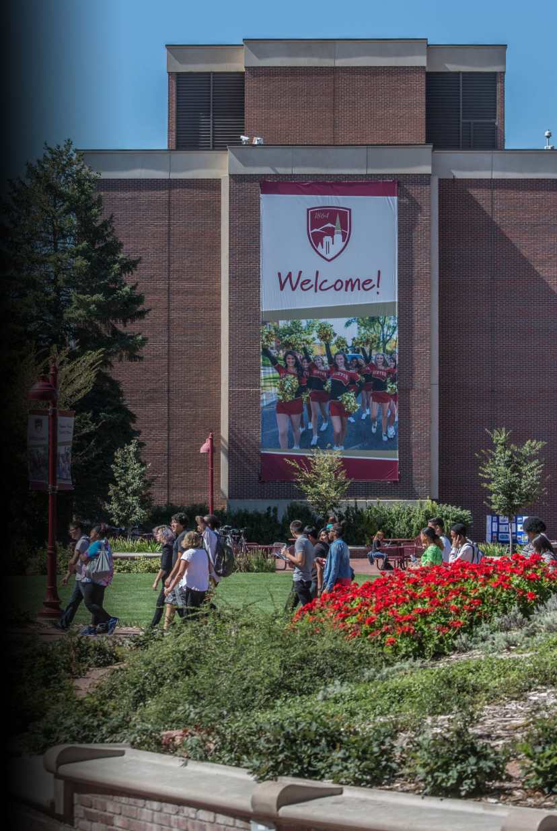
First-Year Student Averages
GPA: 3.76
SAT: 1279
ACT: 28
First-Year Student Middle 50% Ranges
GPA: 3.6-4.0
SAT: 1190-1370
ACT: 26-32
Meet the Admitted Students, Fall 2019
Notes:
Accepted Student profile - TAKE AWAY
Seek academically prepared students who will be successful on our campus
Focus on middle 50%
Clarify GPA (weighted) and SAT (1600 scale)

Slide 12
Wait list and Denies
Hundreds of “admissible” students are waitlisted or denied each year for downward trends and/or disciplinary infractions (many would have received merit scholarships)
A sampling from previous years:
4.0 GPA, 34 ACT- disciplinary case for harassment
3.78 GPA, 30 ACT, 1330 SAT- downward trend (multiple Ds and Fs)
3.34 GPA, 30 ACT, 1220 SAT- downward trend
3.88 GPA, 25 ACT, 1220 SAT- downward trend

Slide 13
“Borderline” Admits
Hundreds of “borderline” students are admitted each year for upward trends, unique circumstances, talent, strong recommendations, rigorous curriculums, etc.
A sampling from previous years:
3.15 GPA, 1280 SAT- Impressive recommendations; strong upward trend
2.62 GPA, 1330 SAT- Death in family; upward trend
3.8 GPA, 18 ACT- English is not first language; Unique and motivated student

Slide 14
Senior Year: Planning for College
Fall
Meet with your school counselor
Get application materials and check deadlines
Take the SAT and/or ACT*
Visit colleges and set up interviews
Winter
Complete/submit the FAFSA, CSS Profile & scholarship applications
Keep working in your classes!
Spring
Review your college acceptances and financial aid awards
Visit campuses you’ve been admitted
Decide on the college you will attend
Summer
Have final transcripts and any college credits sent to your college

Slide 15
Application Types
Early Decision: Binding plan where students make a commitment to a first-choice school if admitted.
Early Action: Non-binding plan that allows applicants to receive an earlier decision; students can still apply to other colleges.
Restrictive Early Action: Non-binding plan but students are restricted from applying EA or ED to other schools.
Regular Decision: Last deadline to apply.
Rolling Admission: Applications reviewed as submitted.

Slide 16
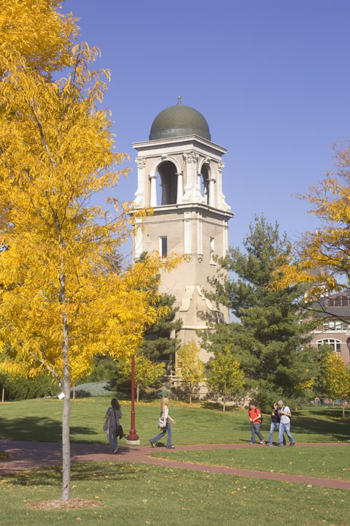
College Essay
Admission Counselors spend 3-10 minutes per essay
Read 40-50 essays a day
Your personal statement needs to function both as an essay and as an advertisement – tell your story!
Honesty is the best policy

Slide 17
Letters of Recommendation
Counselor: Discuss the student in the school
Teacher: Discuss the student in the classroom
Leadership/Community: Discuss the student in the community

Slide 18
What can I do?!
Get good grades, be mindful of your grade trend
Take balanced coursework
Lots of activities and community service won’t make up for the first two points
Study for the ACT or SAT*
Demonstrate your interest
Start brainstorming college essay topics
Do your research; apply to a range of schools
Decide when to apply
Create a calendar of important dates
Select one email address for all college correspondence
Be authentic; to yourself and to the school
Remember: Not getting into a school does not equate to failure.

Slide 19
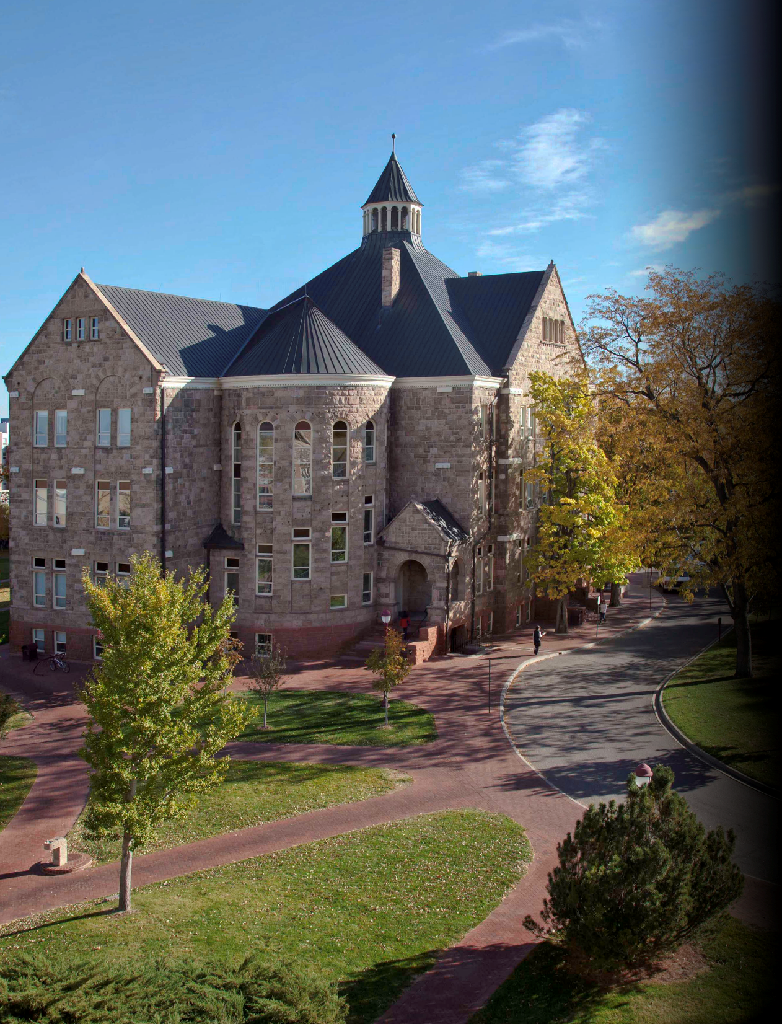
Undergraduate Admission
2197 S. University Blvd.
Denver, CO 80208-9401
303-871-2036
Fax: 303-871-3301
admission@du.edu
www.du.edu/admission
“Today’s students are unsatisfied with the status quo; they are leaders, doers, makers, and innovators. Through a hands-on, immersive, globally-impactful educational experience, they will be the world’s next great change-makers.”
#DUthis
Chancellor Jeremy Haefner
Notes:
Contact Us - TAKE AWAY
Admission Counselor contact info
Social Media connections
Thanks for coming!

